Slide 1
Character Development
Session 06

Slide 2
Outline Material
The goal of character design
The nature of game character
The relationship between player and avatar
Visual appearances
Character depth
Creating compelling character
Audio design
Case Study

Slide 3
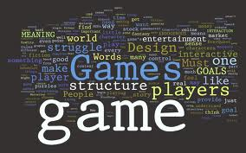
The goal of character design
If we are to create games that have great stories in them, these stories must contain memorable characters.
How are characters in games different than characters in other media (Novel or Movie) ?

Slide 4
The nature of game character
Novel Characters
Holden Caulfield :The Catcher in the Rye.
Humbert Humbert: Lolita.
Tom Joad: The Grapes of Wrath.
Ralph: Lord of the Flies.
Sethe: Beloved.
Holden is a teenager who wrestles with the phoniness and ugliness of the adult world.
Humbert is an adult consumed by lust for an adolescent girl.
Tom is an ex-convict who tries to help his family after they lose their farm.
Ralph and many other children are stranded on an island and try to survive the island and each other.
Sethe is a woman who tries to rebuild her life after she and her daughter escape from slavery

Slide 5
The nature of game character
Movie Characters
Rick Blaine: Casablanca.
Rick must choose between the love of his life and saving the life of her husband.
Indiana Jones: Raiders of the Lost Ark.
An adventurous archaeologist must rescue the Ark of the Covenant from the Nazis.
Rose DeWitt Bukater: Titanic.
A young woman falls in love on the ill-fated Titanic.
Norman Bates: Psycho.
A man with an unusual case of schizophrenia commits murders and tries to cover them up.
Don Lockwood. Singin’ in the Rain.
A silent film actor struggles to make the transition to talkies.

Slide 6
The nature of game character
Game Characters
Mario: Super Mario Brothers.
A cartoon plumber battles enemies to rescue a princess from an evil king.
Solid Snake: Metal Gear Solid.
A retired soldier infiltrates a nuclear weapons disposal facility to neutralize a terrorist threat.
Cloud Strife: Final Fantasy VII.
A band of rebels tries to defeat an evil megacorporation run by an evil wizard.
Link: Legend of Zelda.
A young man must recover a magic artifact to rescue a princess from a villain.
Gordon Freeman: Half-Life 2.
A physicist must battle aliens when an experiment goes horribly wrong.

Slide 7
The nature of game character
Mental → Physical
The characters in the novels are involved in deep psychic struggles.
The characters in the movies are involved in both emotional and physical struggles, which are resolved through combinations of communication and action.
The game characters are involved in conflicts that are almost entirely physical. Since these characters mostly have no thoughts (the player does the thinking for them) and are only occasionally able to speak, this again makes perfect sense.

Slide 8
The nature of game character
Reality → Fantasy
The novels tend to be very reality based.
The films tend to be rooted in reality, but often pushing towards fantasy.
The game worlds are almost entirely fantasy situations, and the characters reflect this, they are products of their environment.
Complex → Simple.
For a variety of reasons, the complexity of the plots and depth of the characters gradually diminishes as we move from novels to games.

Slide 9
The relationship between player and avatar
There is something magical about the character that a player controls in a game. So magical that we give that character a special name: the avatar.
The word is derived from a Sanskrit word that refers to a god magically taking physical form on the earth.
The name is well chosen for a game character, since a similarly magical transformation takes place when a player uses their avatar to enter the world of the game.

Slide 10
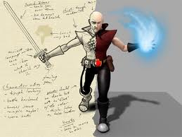
The relationship between player and avatar
There are times when the player is distinctly apart from the avatar, but other times when the player’s mental state is completely projected into the avatar, to the point that the player gasps if the avatar is injured or threatened

Slide 11
Visual appearances
Art-Driven Character Design
Visual Design
Physical Design and Super-Sensuality
Cute Sidekicks
Story-Driven Character Design
The character needs to intrigue the player
The character needs to get the player to like him
The character needs to change and grow according to experience.

Slide 12
Character depth
Increased Awareness
Limited Awareness
Mastery
Reluctance to Change
Overcoming
Final Attempt
Act 1
Act 3
Committing
Rededication
Experimenting
Act 2
Preparing
Consequences
Big Change

Slide 13
Creating Compelling Game Characters
Character Functions:
Hero: The character who plays the game
Mentor: Gives advice and useful items
Assistant: Gives occasional tips
Tutor: Explains how to play the game
Final Boss: Someone to have the last battle against
Minions: Bad guys
Three Bosses: Tough guys to battle against
Hostage: Someone to rescue

Slide 14
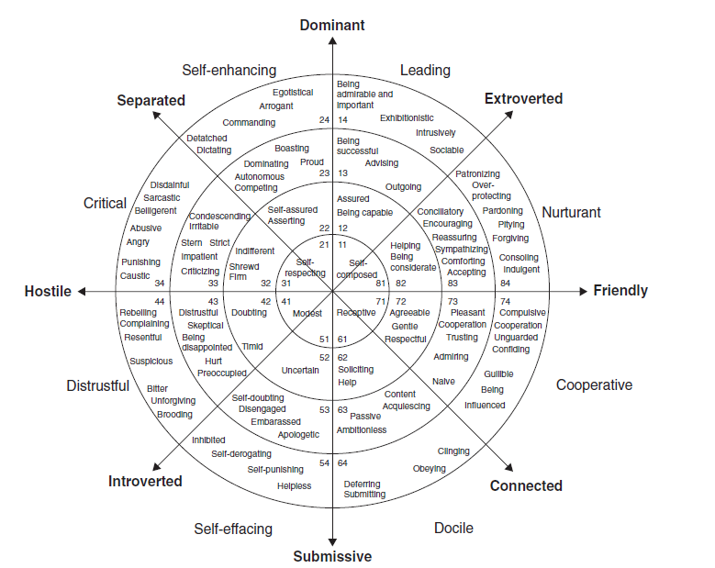
Creating Compelling Game Characters
Interpersonal Circumplex

Slide 15
Audio design
Sound effect and Music
Themes
Psychological expectations
Sound is a signal of events (injury, damages, death)
Deep sounds suggest slow and strong characters, high sounds suggest light and fast one.
Voice and Language
Vocabulary indicates the age, social class, and level of education.
Grammar also convey social class, and level of education.
Accents tells us the origin and social class of the character.

Slide 16
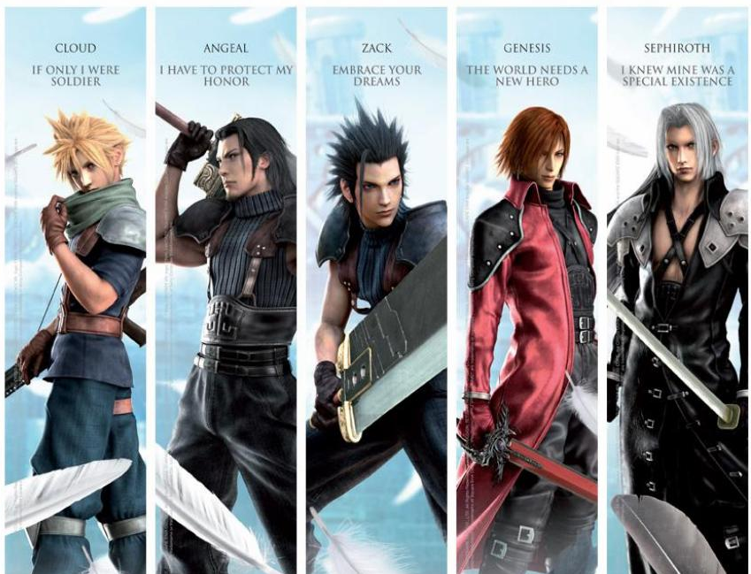
Case Study
Make a group of six and discuss about the following characters:

